Slide 1
Relative Humidity Trends in Reanalysis Data
28.07.2023 Florian Pausewang s6flpaus@uni-bonn.de

Slide 2
Research Questions
Role of water vapor in the atmosphere:

Slide 3
Research Questions
Role of water vapor in the atmosphere:
Assumption: Relative humidity (RH) stays approximately constant under warming (?)
Analyse T and RH distributions and changes in the past climate
Compare T and RH in different data sets

Slide 4
Used Data:
Global longterm reanalysis data
Variables: Temperature and Relative Humidity
Frequency: monthly
JRA-55
Merra-2
JRA-55 Monthly Variance of 1.25 Degree Isobaric Analysis Fields
Dimensions: (lat: 145, lon: 288, p: 37)
Time range: 1959-2021
MERRA2_inst3_3d_asm_Cp
Dimensions: (lat: 361, lon: 576, p: 42)
Time range: 1980-2023
Notes:
Present Data

Slide 5
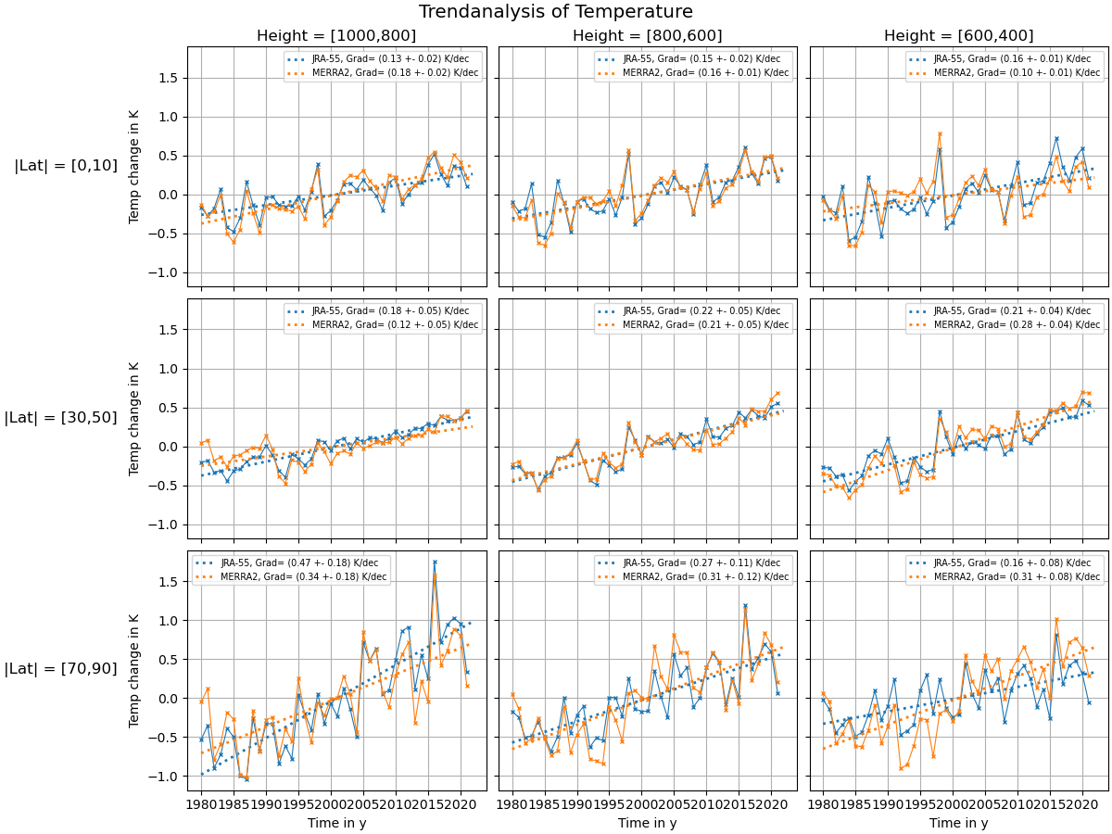
Trendanalysis
→ Both datasets agree on the same rising temperature trend

Slide 6
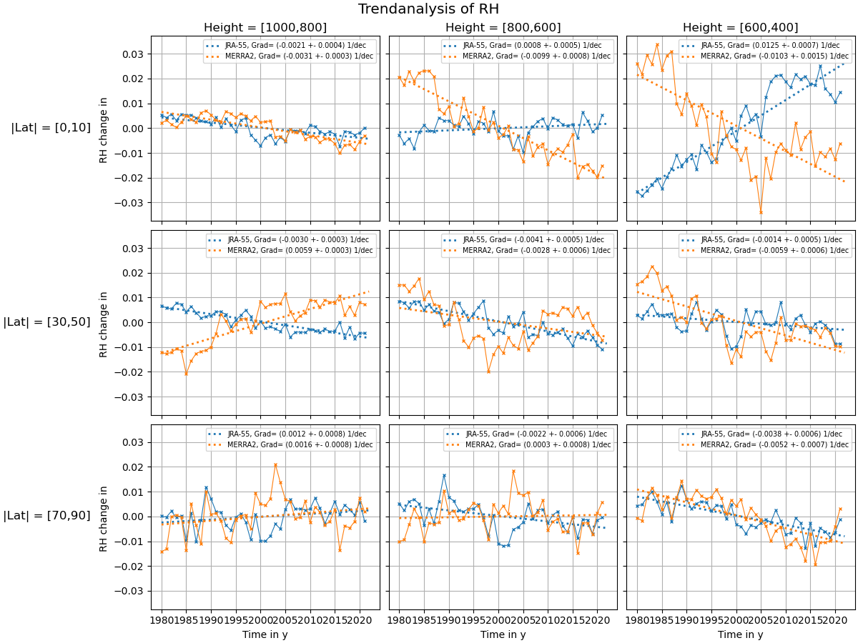
Trendanalysis
→ The datasets differ in the RH trend in the free troposphere

Slide 7
Trendanalysis
→ The datasets show similar RH trends for higher latitudes again

Slide 8
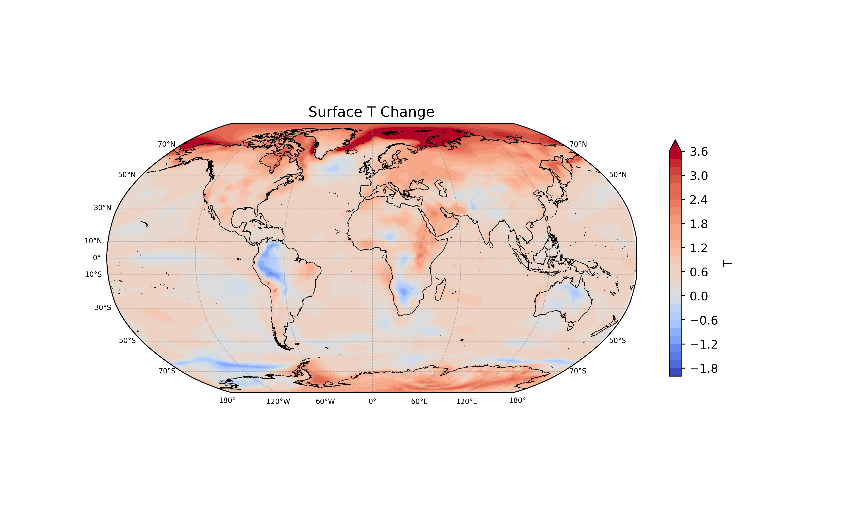
Surface trends
JRA-55
[2007-2021] - [1958,1973]
With small exceptions: Global warming trend
Effects like Arctic amplification, land heating

Slide 9
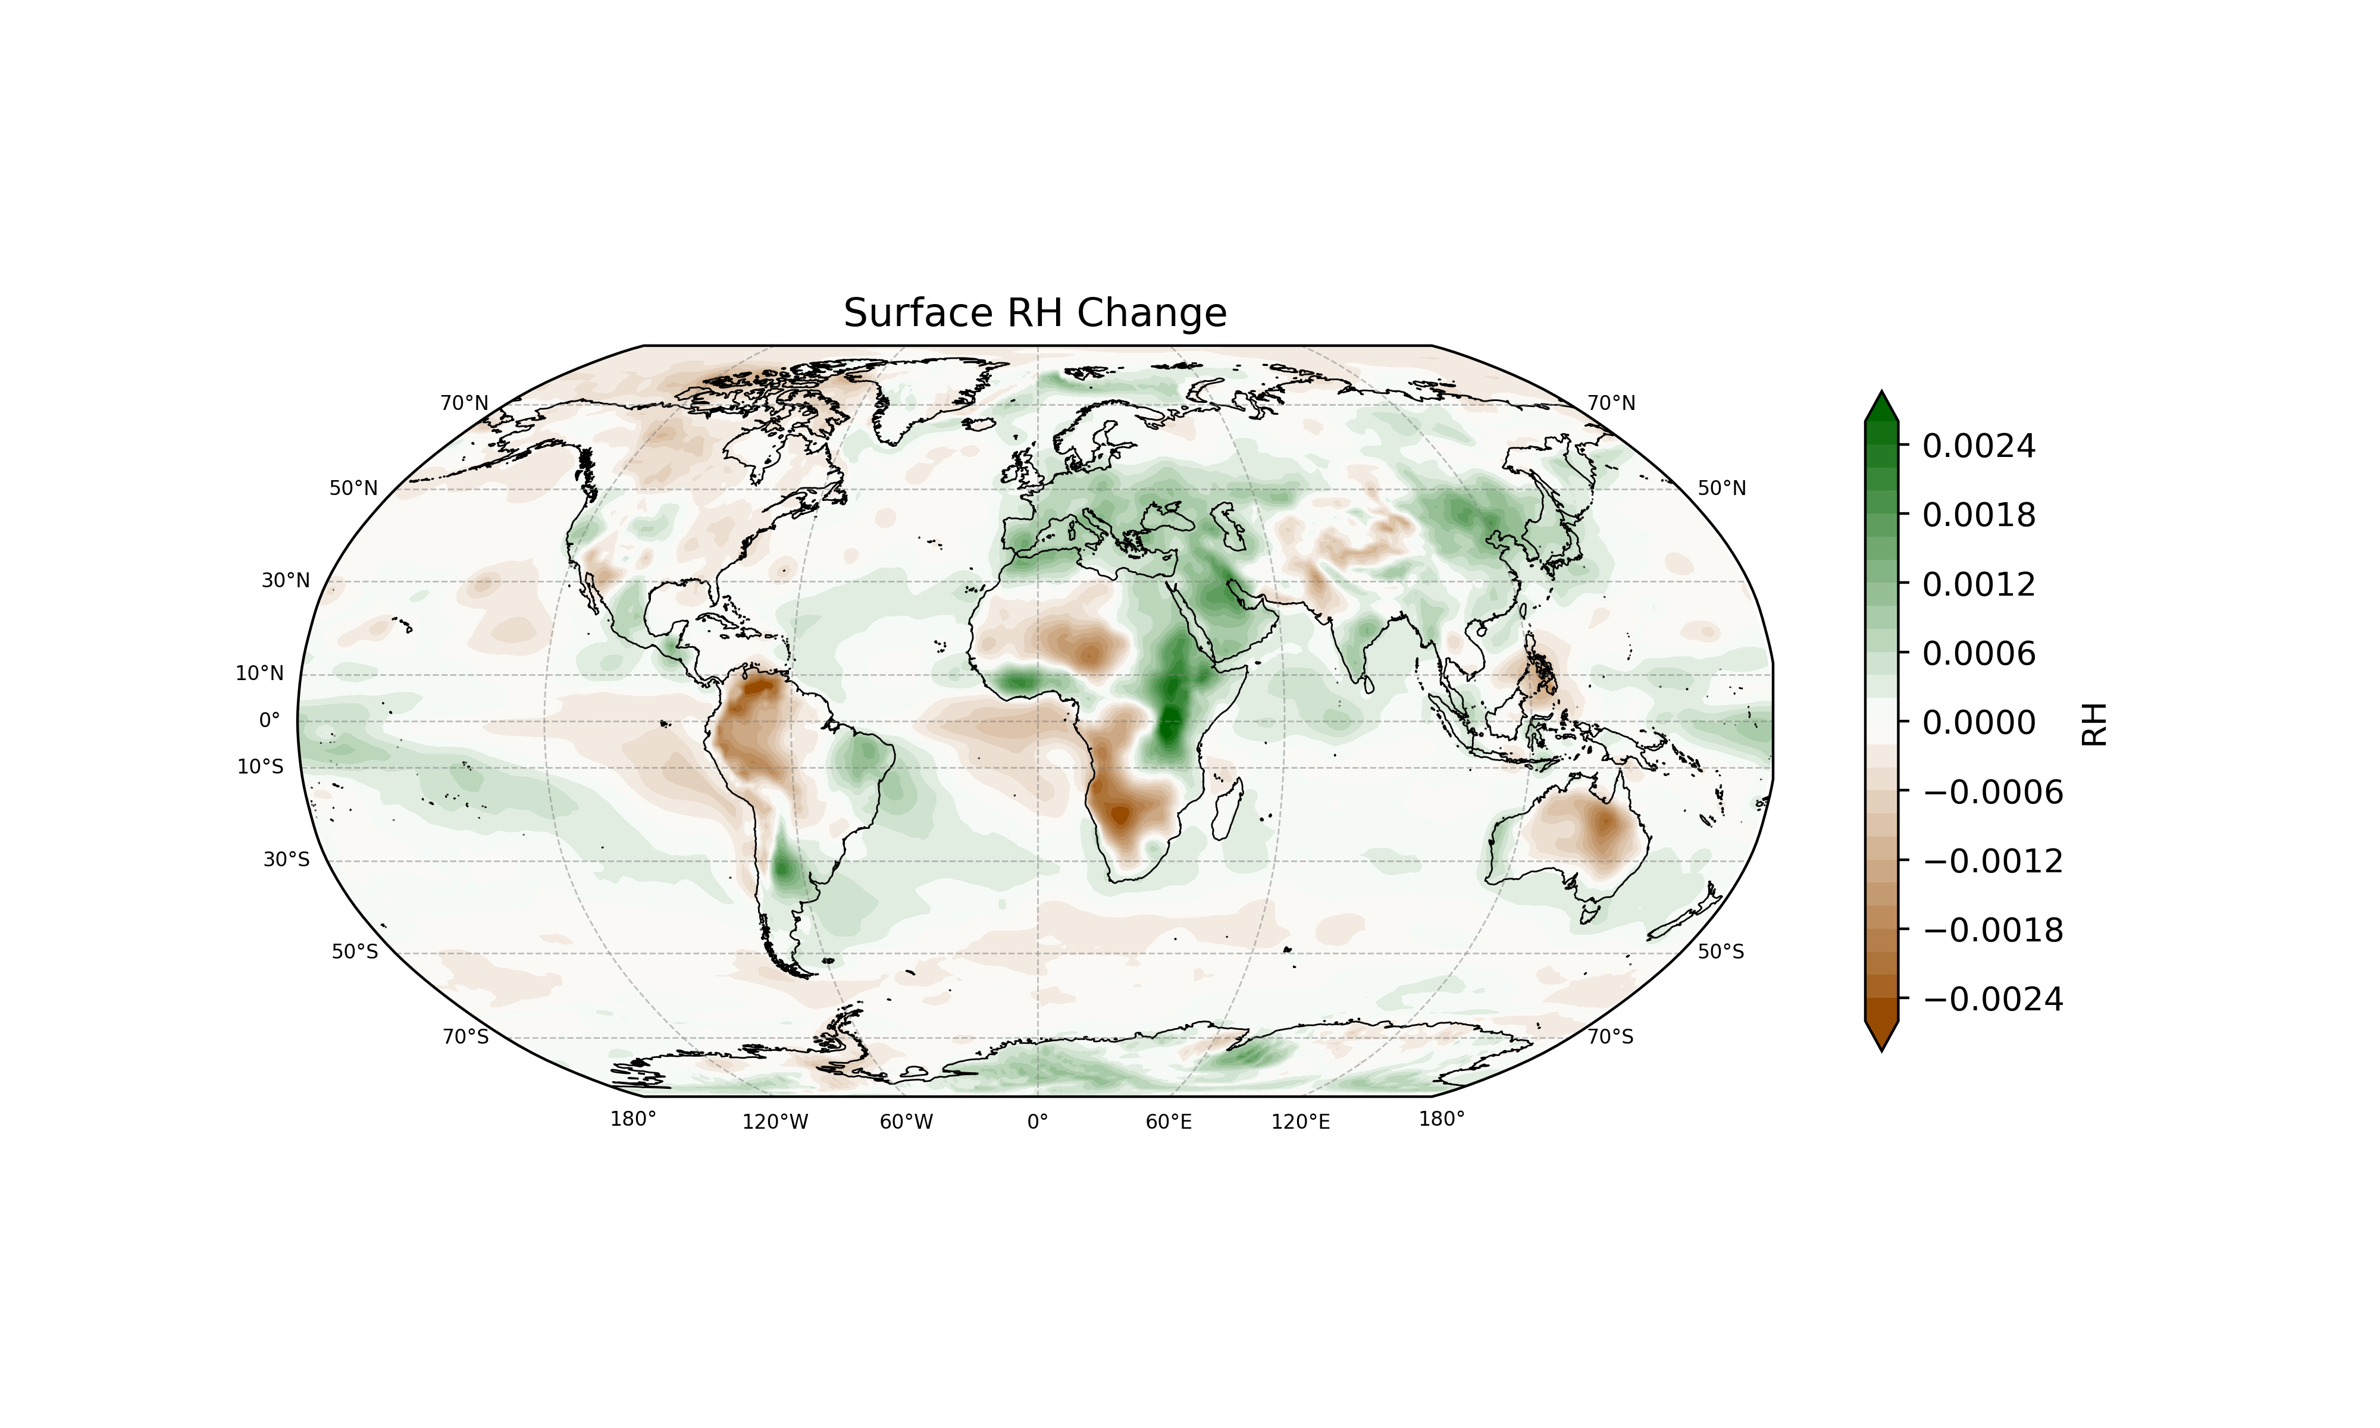

Surface trends
JRA-55
[2007-2021] - [1958,1973]
Comparable small change of surface RH ($\sim ±$ 0.2%)
In general: RH changes smaller over water

Slide 10
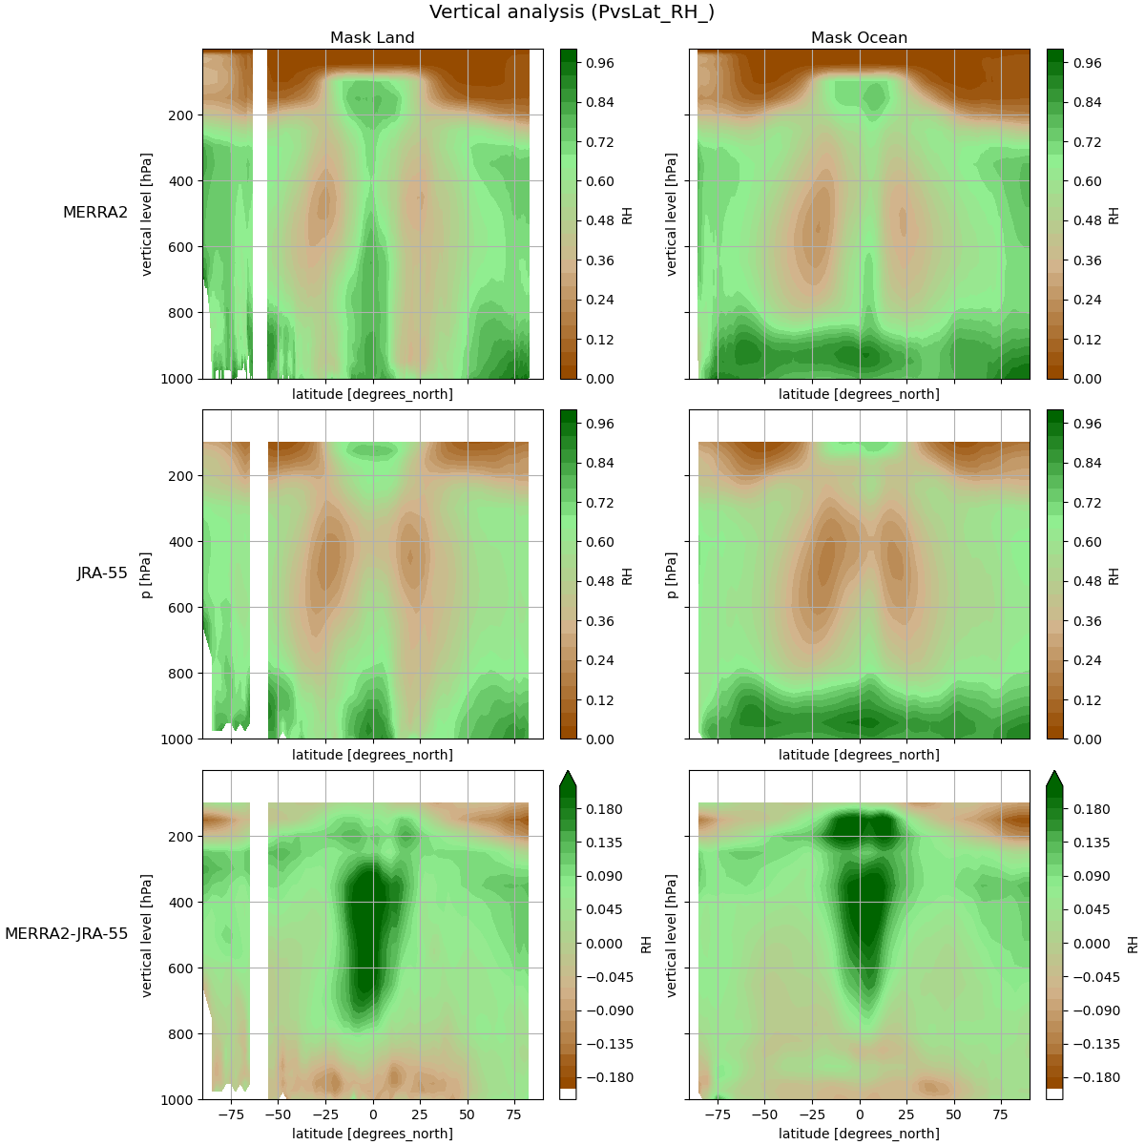
Vertical analysis and trends
Mean RH (1980-2020):
Stratosphere and lower troposphere: JRA-55 moister
Free/upper troposphere: Merra2 moister Strong deviation in tropics

Slide 11
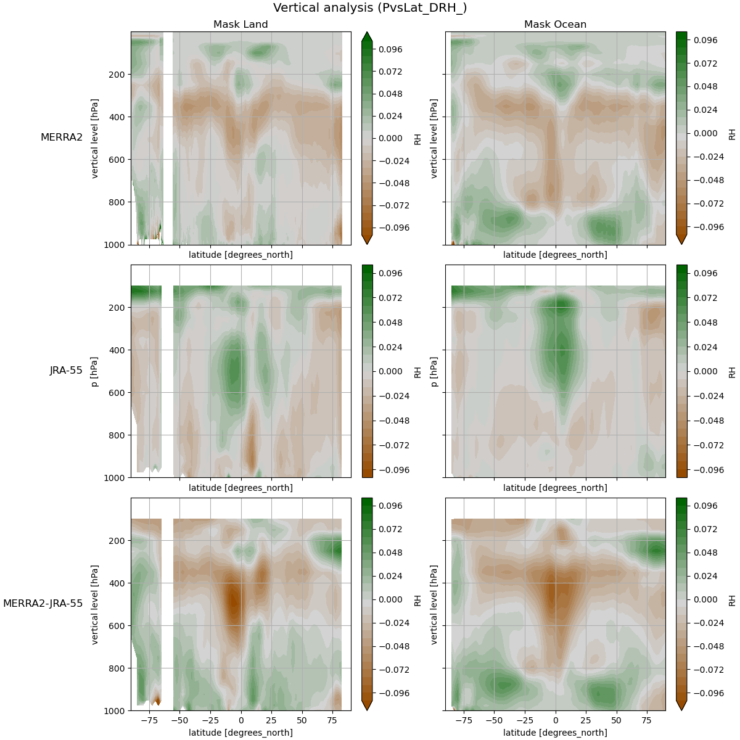

Vertical analysis and trends
$$∆$$
Left: Mean RH (1980-2020):
Stratosphere and lower troposphere: JRA-55 moister
Free/upper troposphere: Merra2 moister Strong deviation in tropics
Right: Change of RH ( (2010-2020) – (1980-1990) )
Different (almost opposite) trends in Merra2 and JRA-55
Outstanding: Tropics
Moister regions get dryer, dryer get moister
$$∆$$
$$∆$$

Slide 12
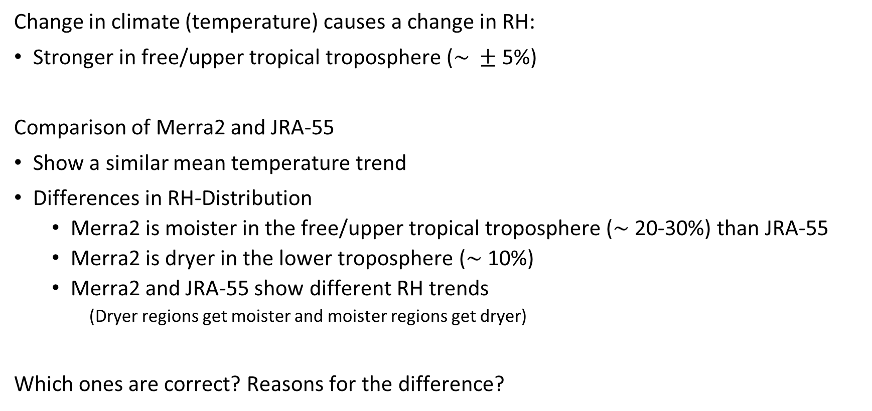
Summary
Change in climate (temperature) causes a change in RH:
Stronger in free/upper tropical troposphere ($\sim ±$ 5%)
Comparison of Merra2 and JRA-55
Show a similar mean temperature trend
Differences in RH-Distribution
Merra2 is moister in the free/upper tropical troposphere ($\sim$20-30%) than JRA-55
Merra2 is dryer in the lower troposphere ($\sim$ 10%)
Merra2 and JRA-55 show different RH trends
(Dryer regions get moister and moister regions get dryer)
Which ones are correct? Reasons for the difference?

Slide 13
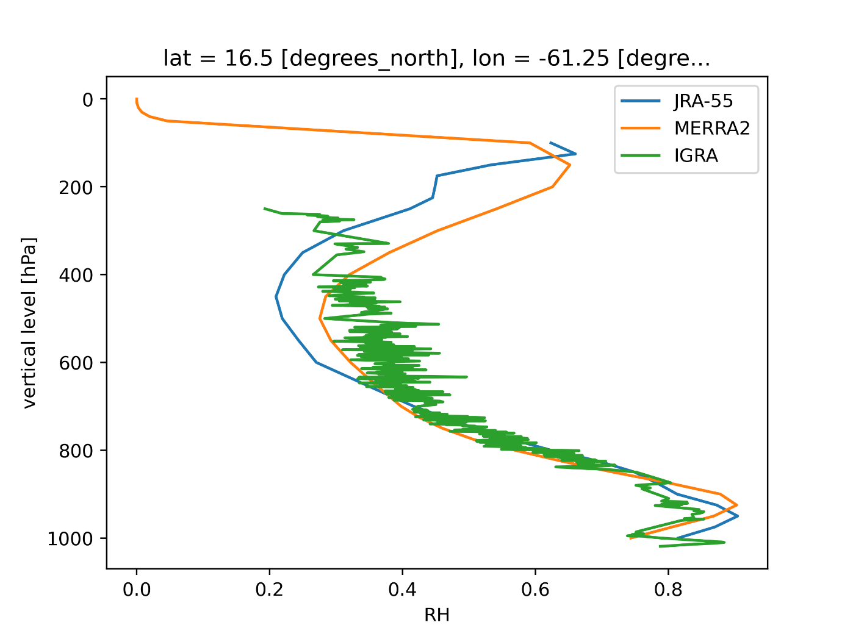
Next Step: Compare with radiosonde-data
Idea: Use independent sonde-data to find the „right“ reanalysis set
Problem:
The calculation of RH is based on different assumptions...
(Using saturation pressure over water or over ice)

Slide 14
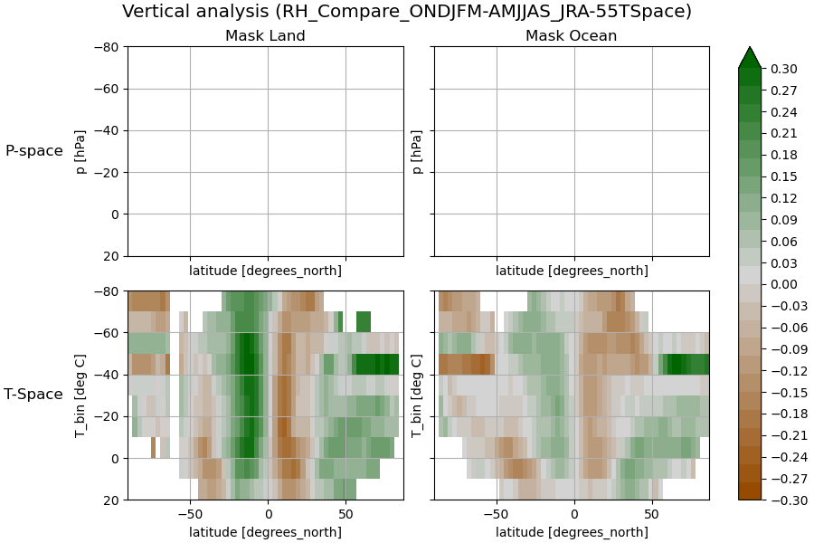
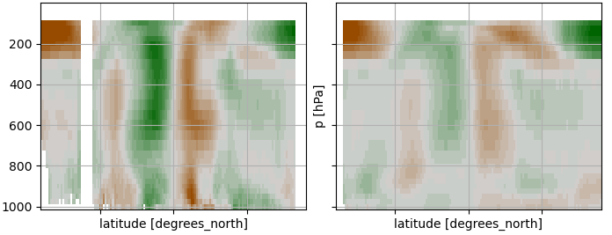
Next Step: Change to a more (physical) system
Problems:
The seasonal cycle signal is stronger than signal of the RH change
The „P-space“ is not the thermodynamic space of water vapor
Idea:
Change to „T-space“ On the right:
Mean RH (1980-2020), JRA
AMJJAS – ONDJFM
No change

Slide 15
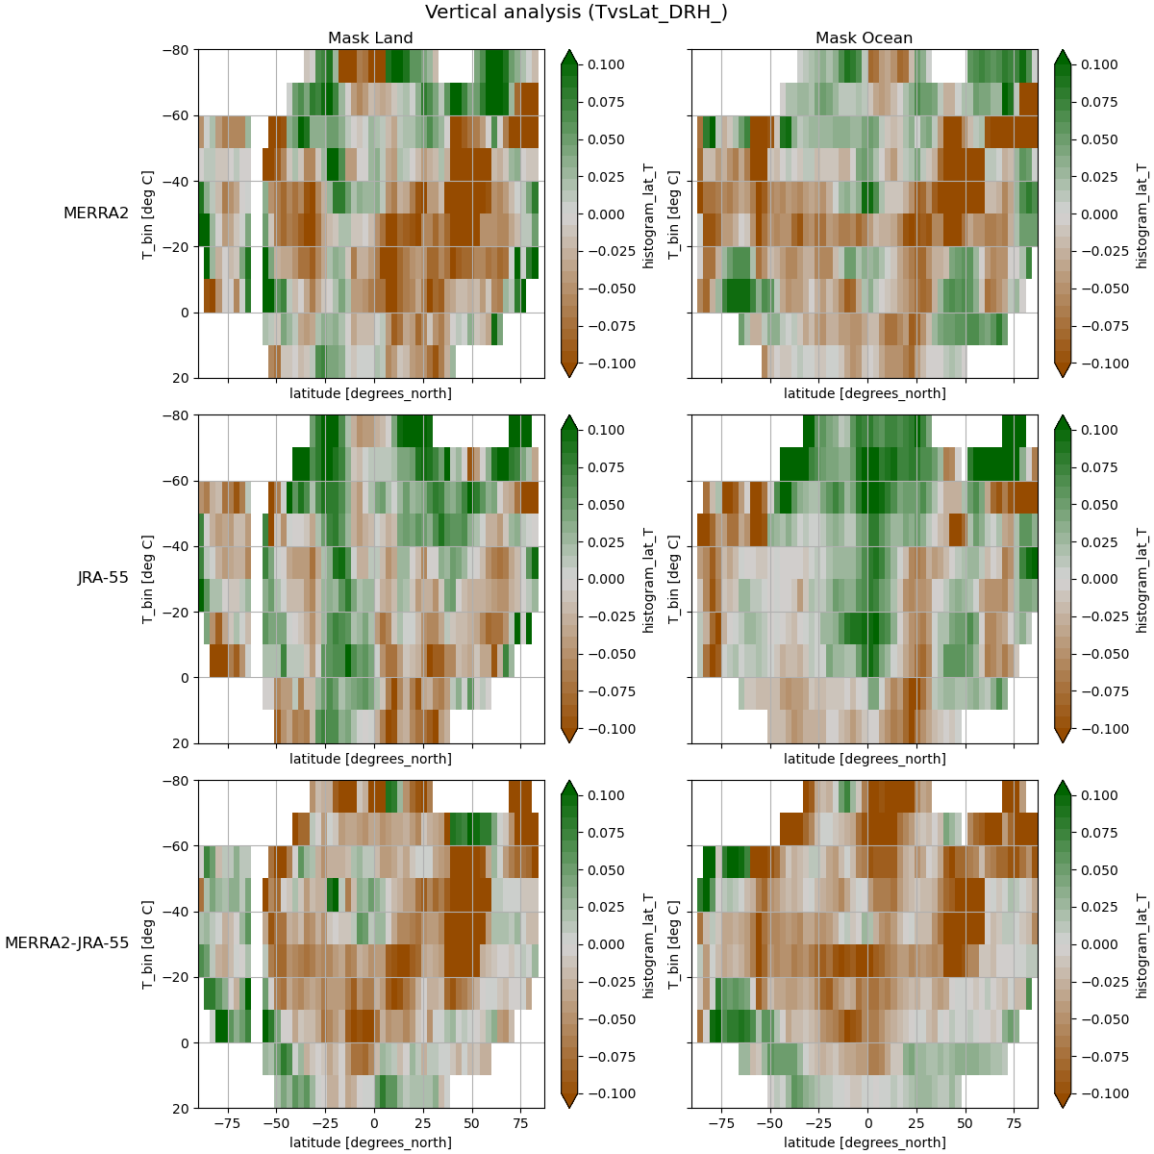

Slide 16
Thank you!

Slide 17
Supplement

Slide 18

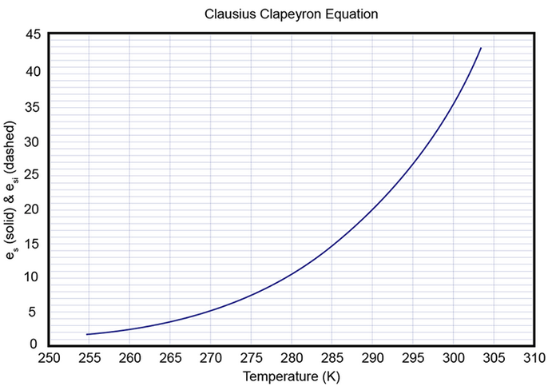

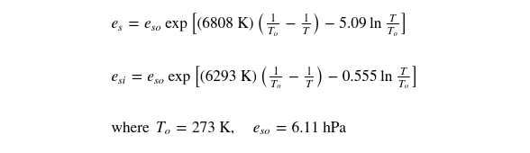

















Clausius–Clapeyron Equation
Solution:
@ https://www.e-education.psu.edu/meteo300/node/584
Notes:
https://www.e-education.psu.edu/meteo300/node/584
l_{v} is the enthalpy of vaporization (often called the latent heat of vaporization, about 2.5 x 10⁶ J kg^{–1}),
l_{v} is not constant with temperature but instead changes slightly (from 2.501 x 10⁶ J kg^{–1} at 0 ºC to 2.257 x 10⁶ J kg^{–1} at 100 ºC).

Slide 21
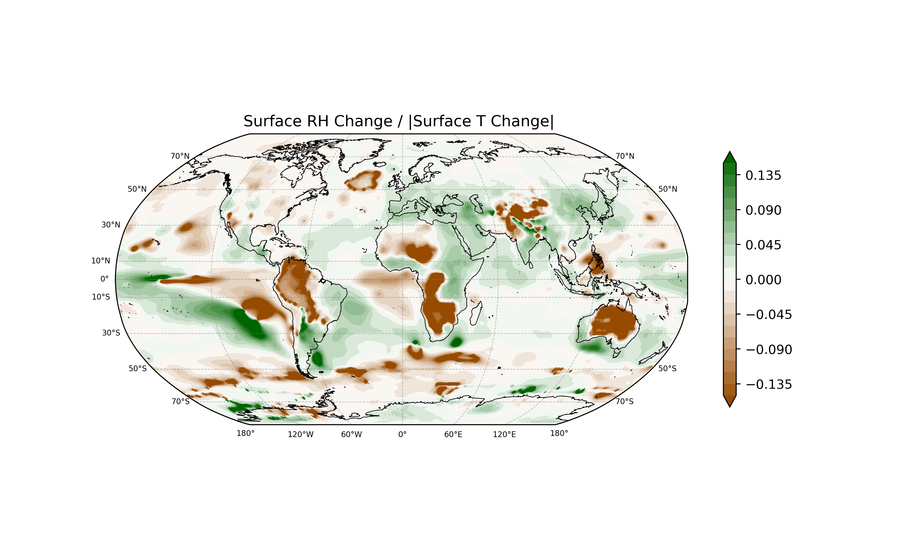
Surface trends
JRA-55
[1958,1973]-[2007-2021]

Slide 22
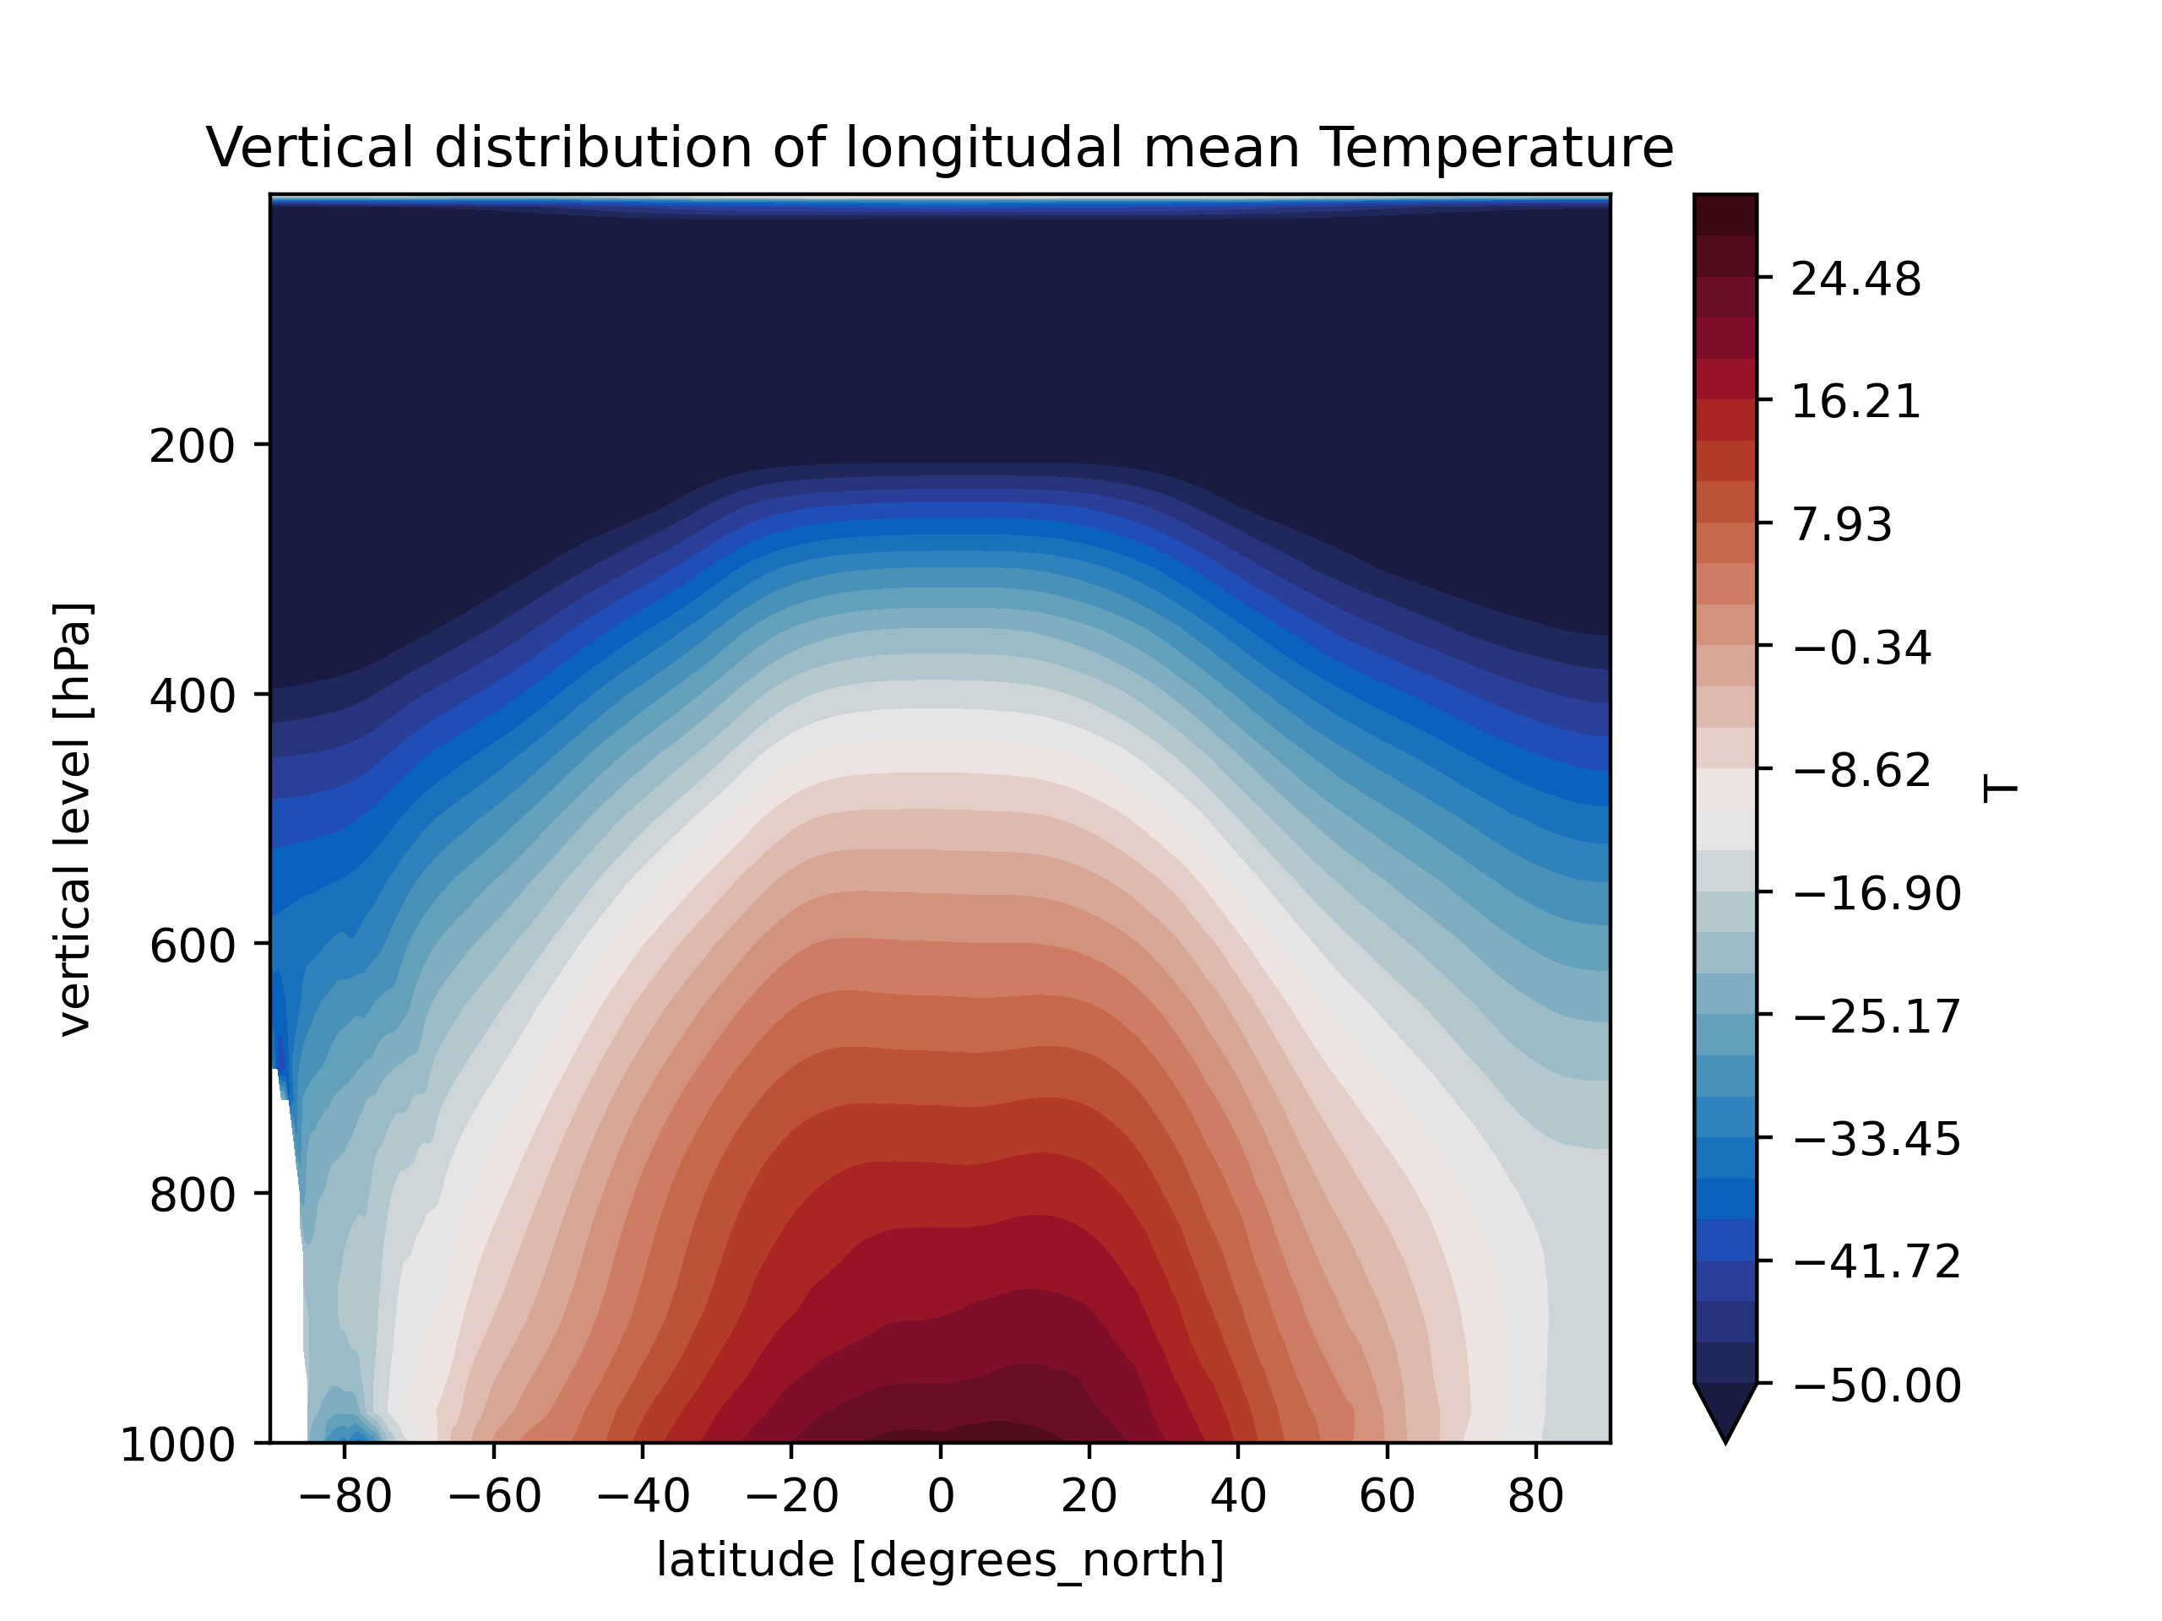
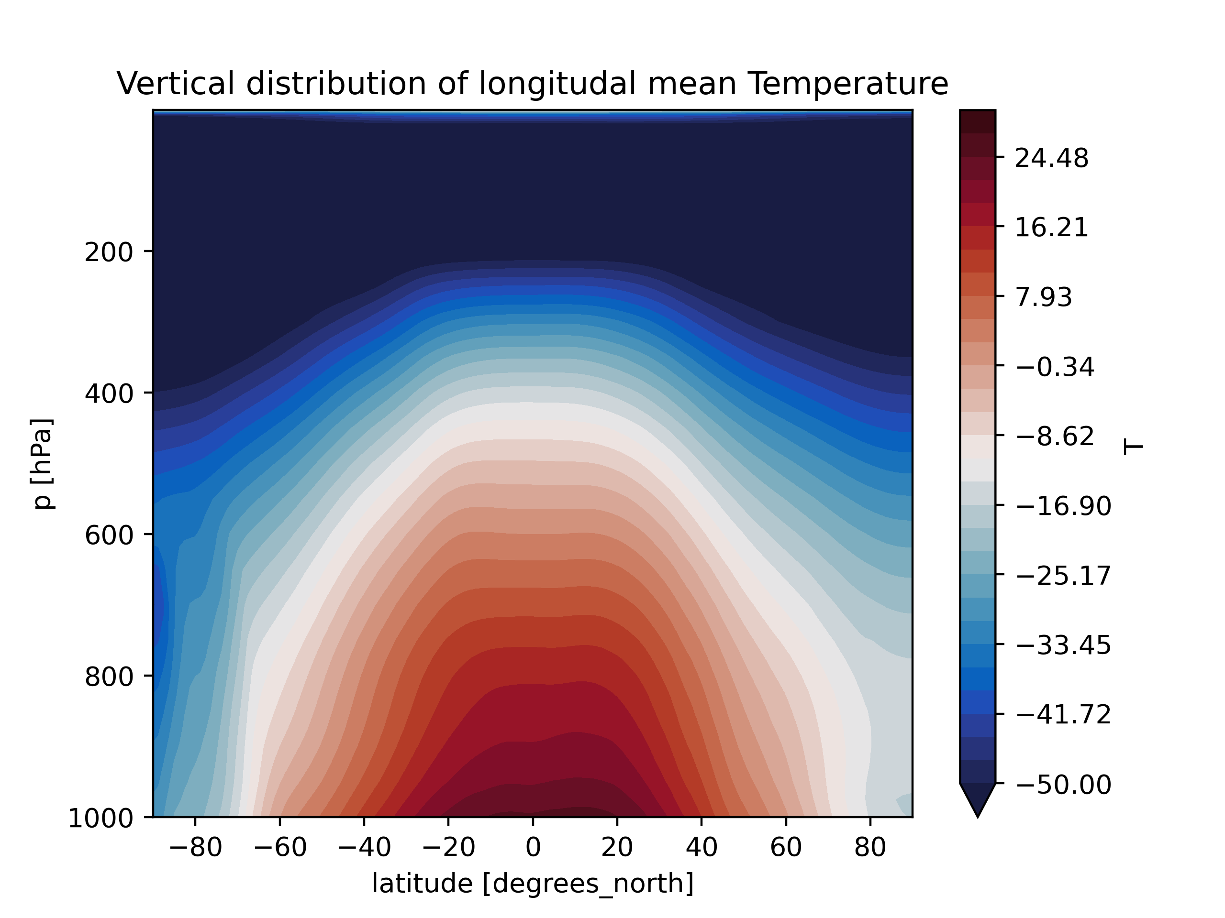
Merra-2 JRA-55

Slide 23

Merra-2 JRA-55

Slide 24
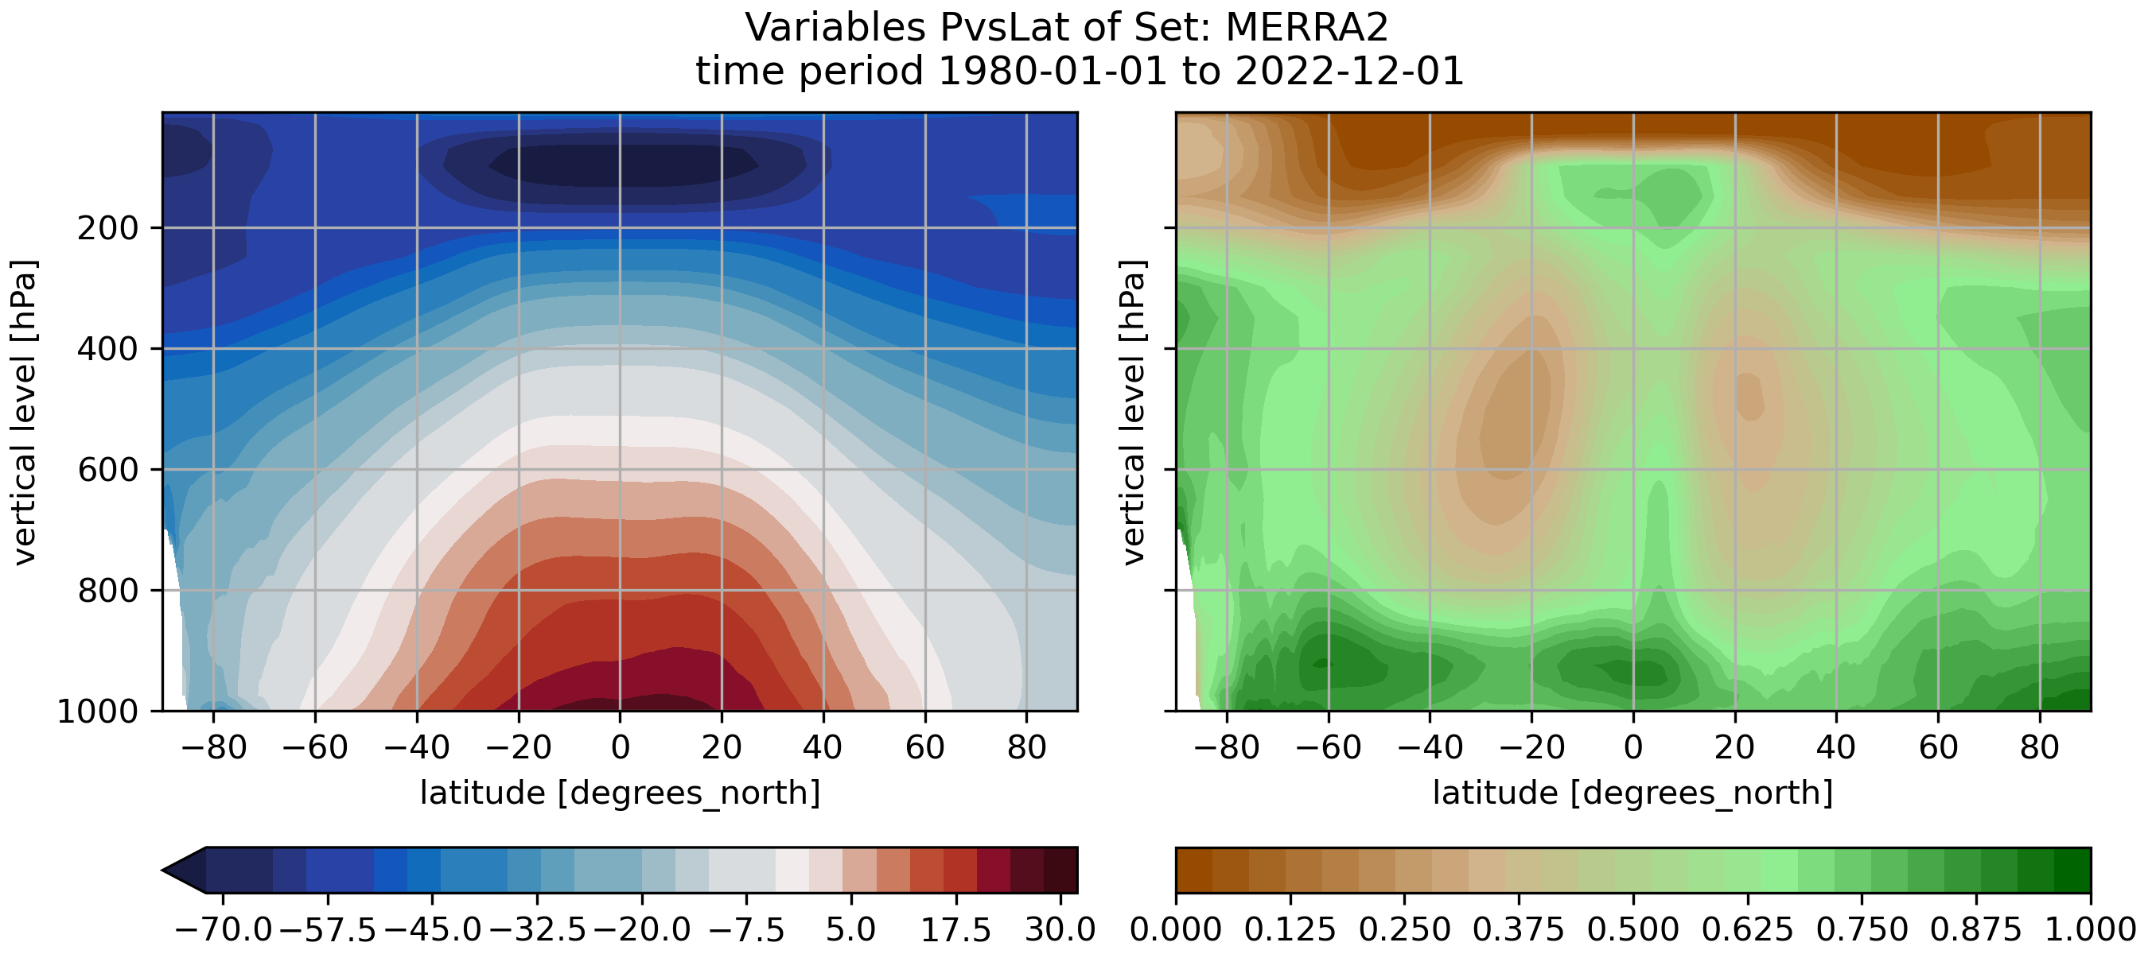
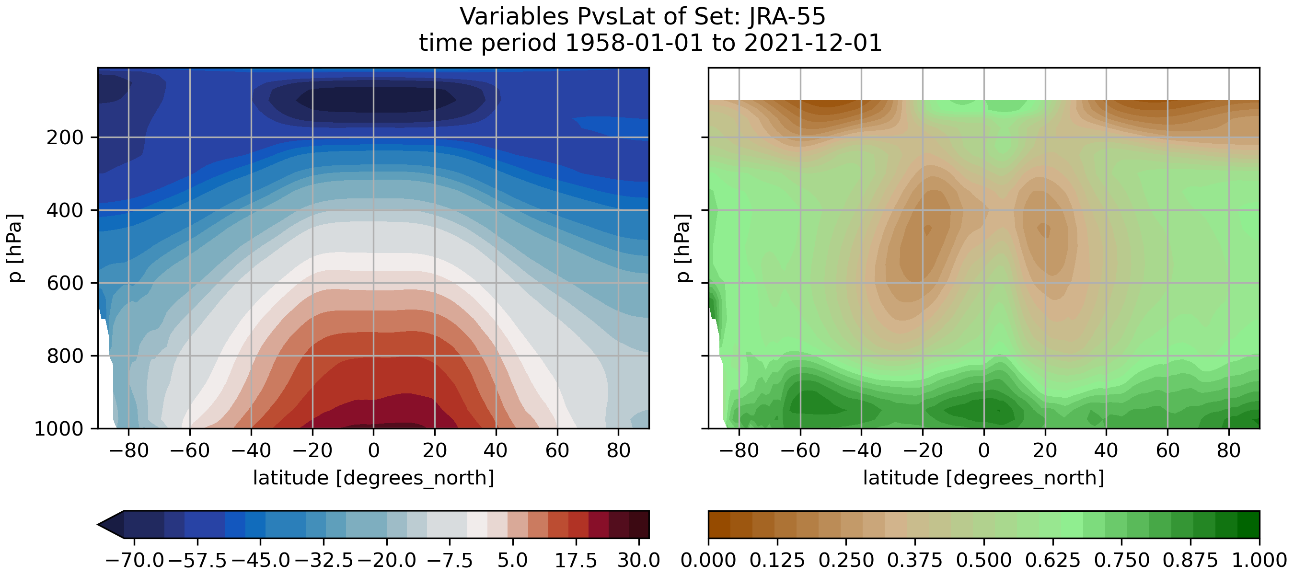

Slide 25
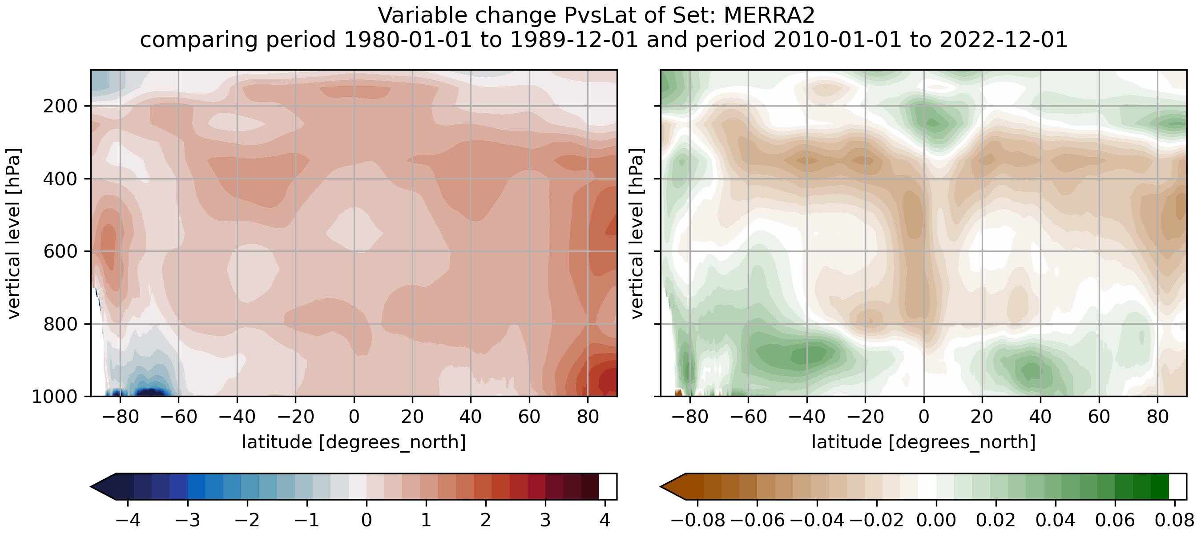
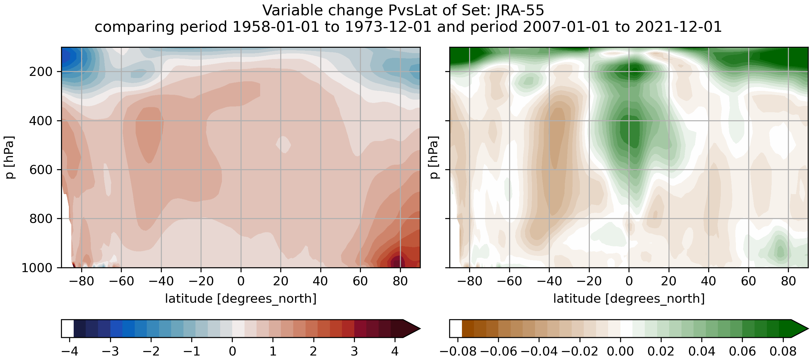

Slide 26
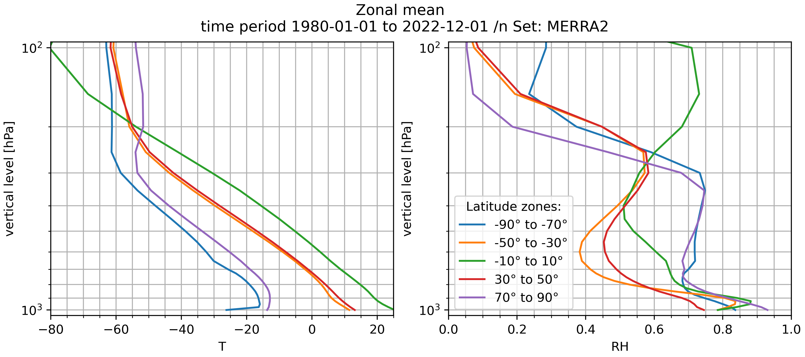
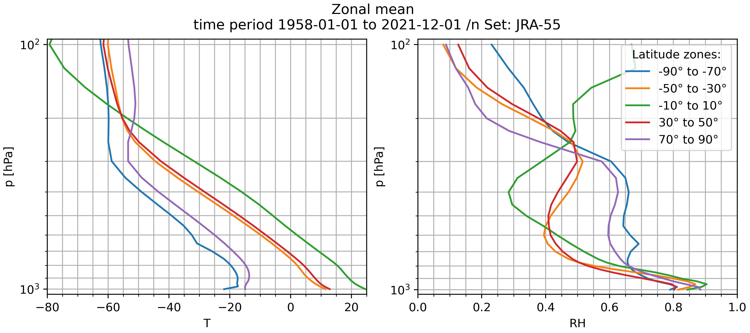

Slide 27
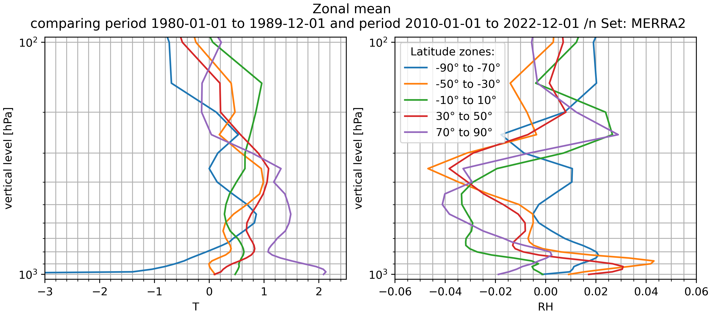
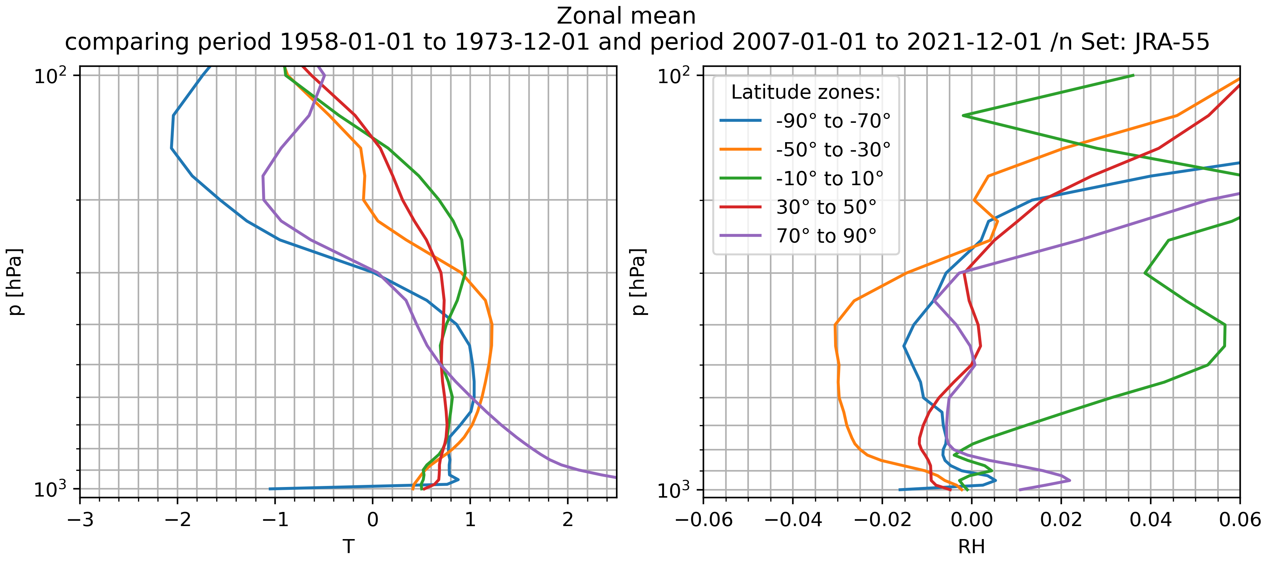

Slide 28
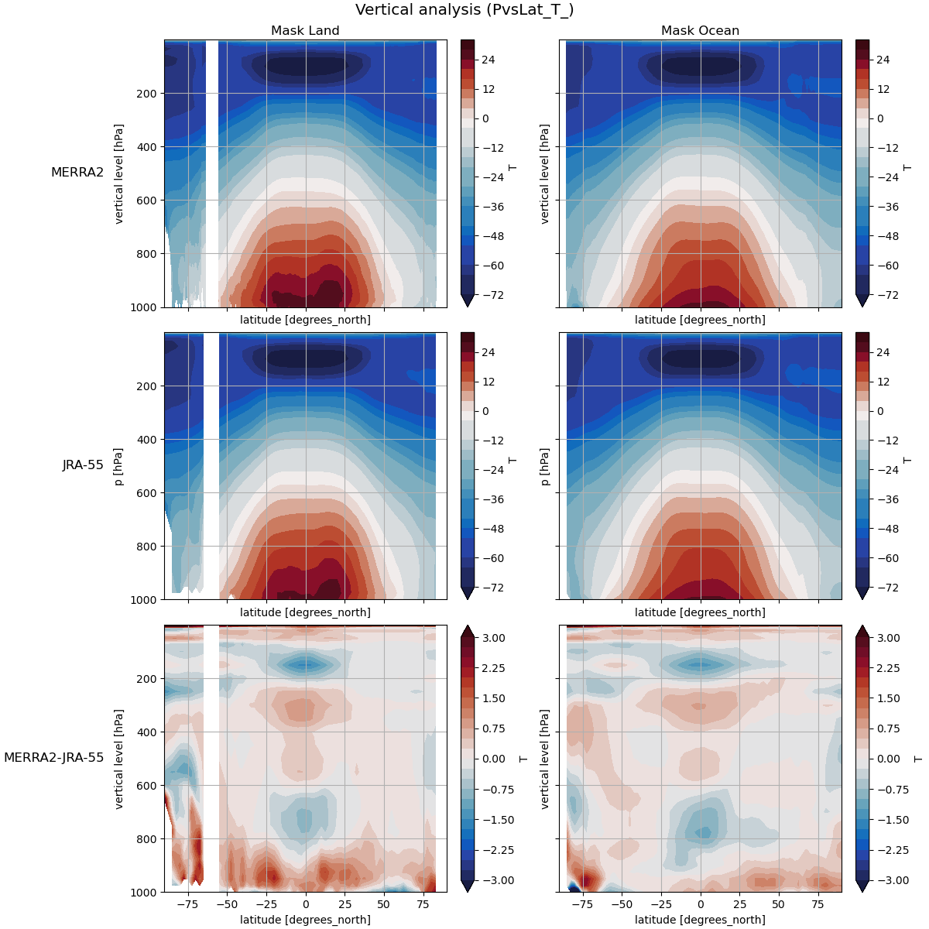
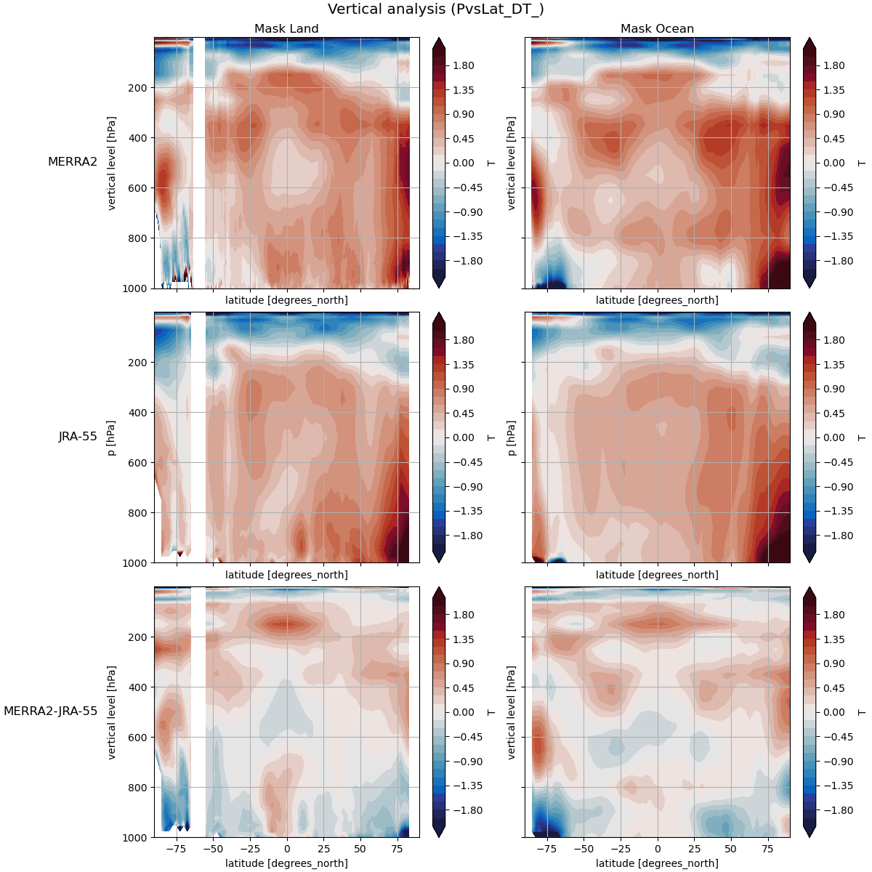

Slide 31
Comparison of the lowest level in the 3D dataset with 2D surface dataset

Slide 32
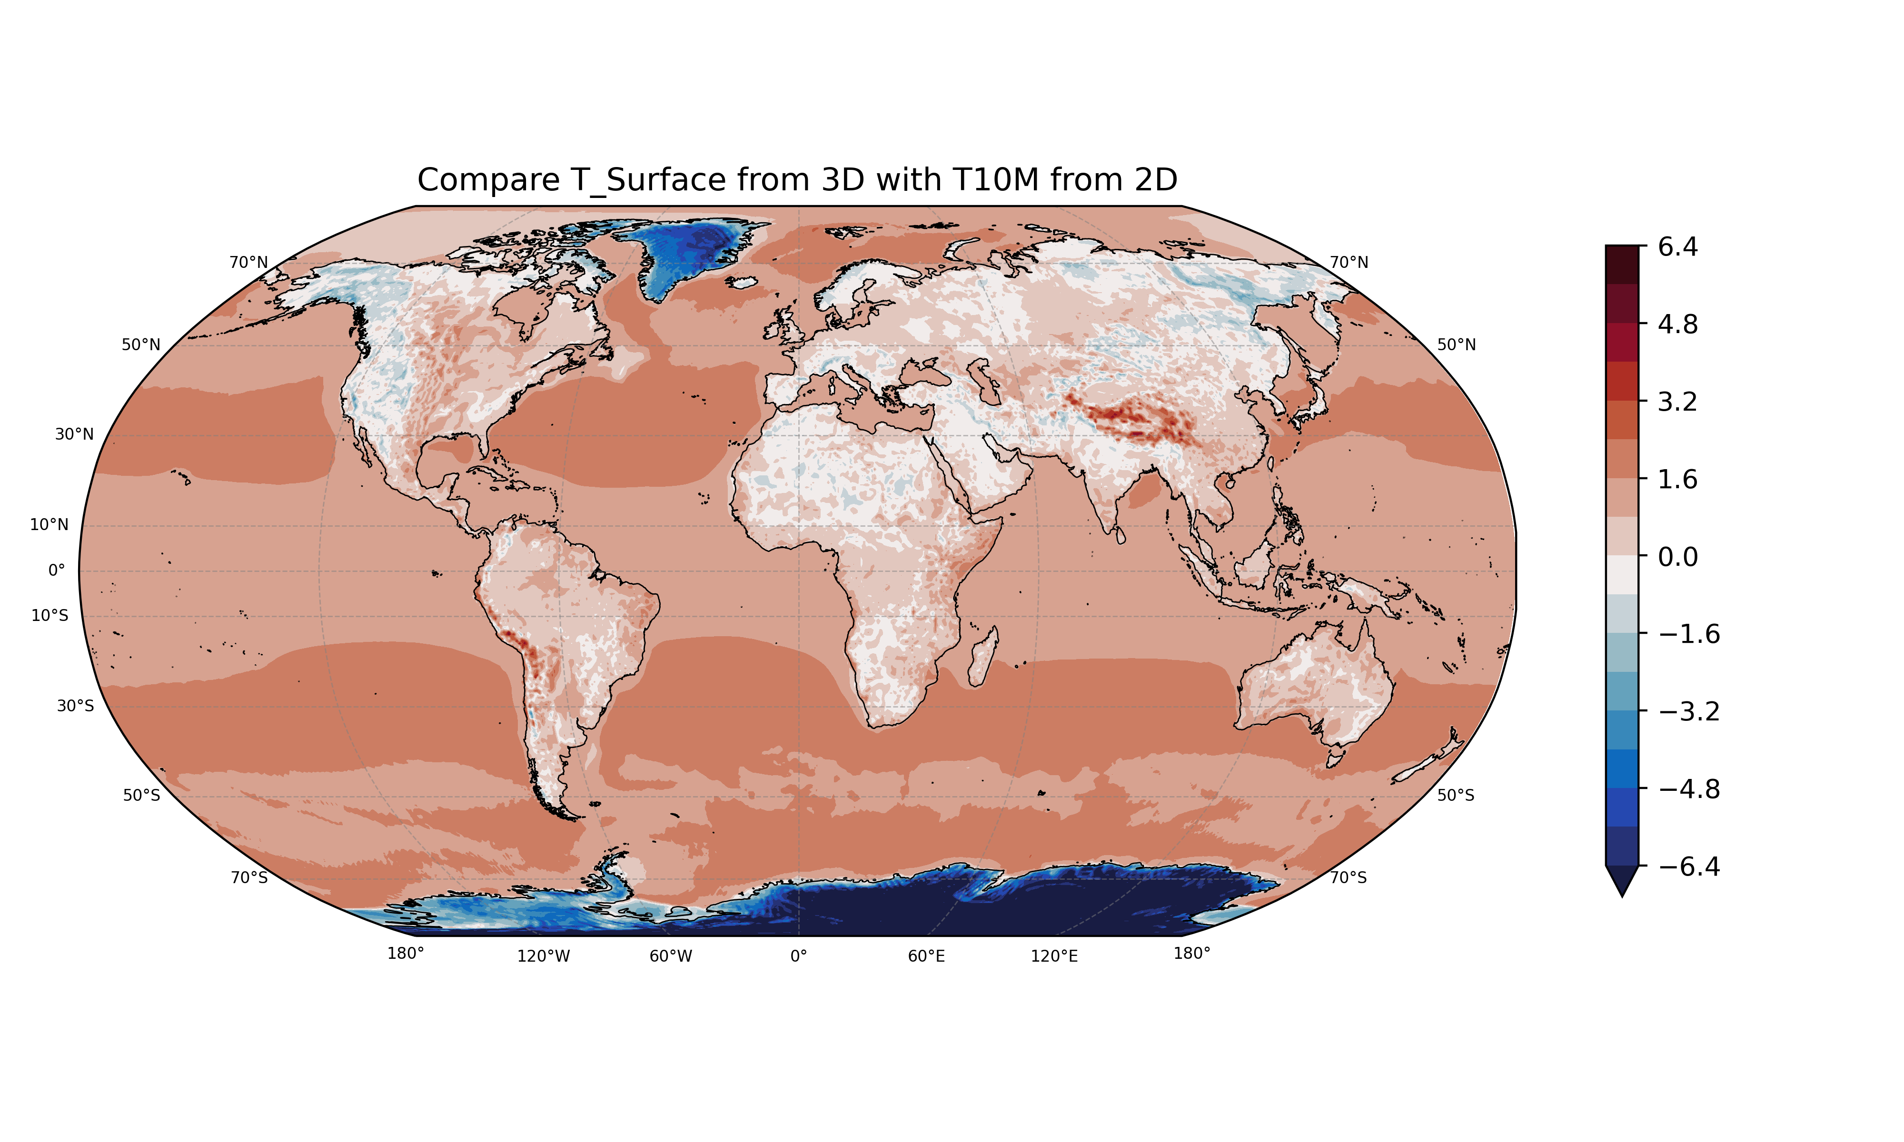
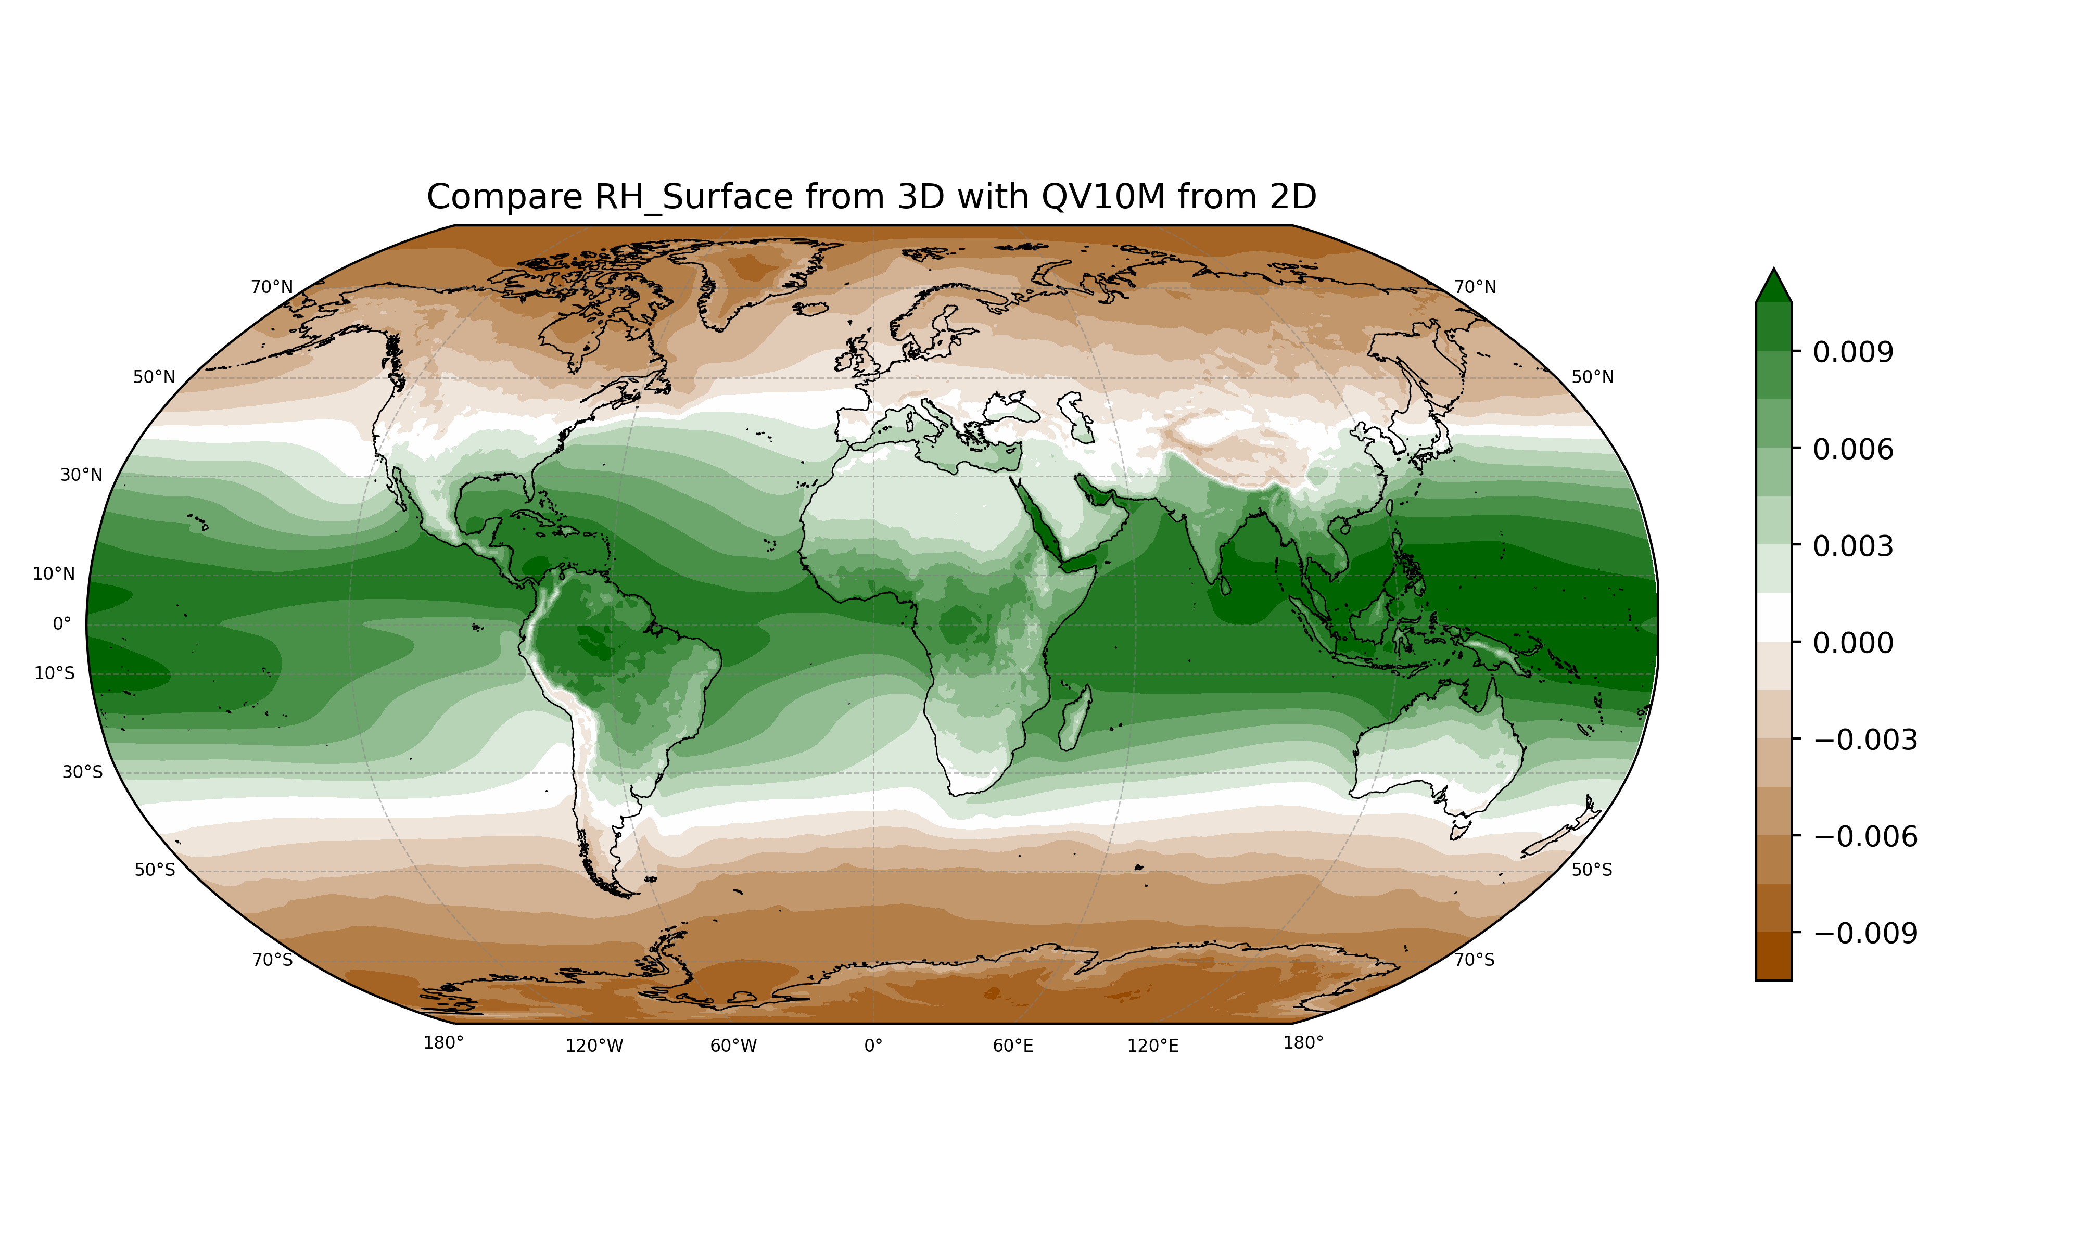
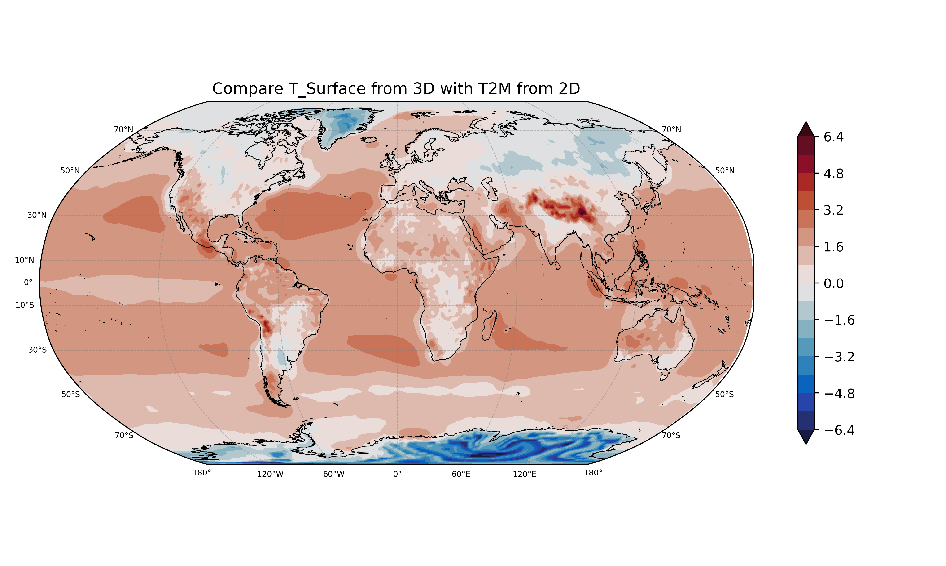
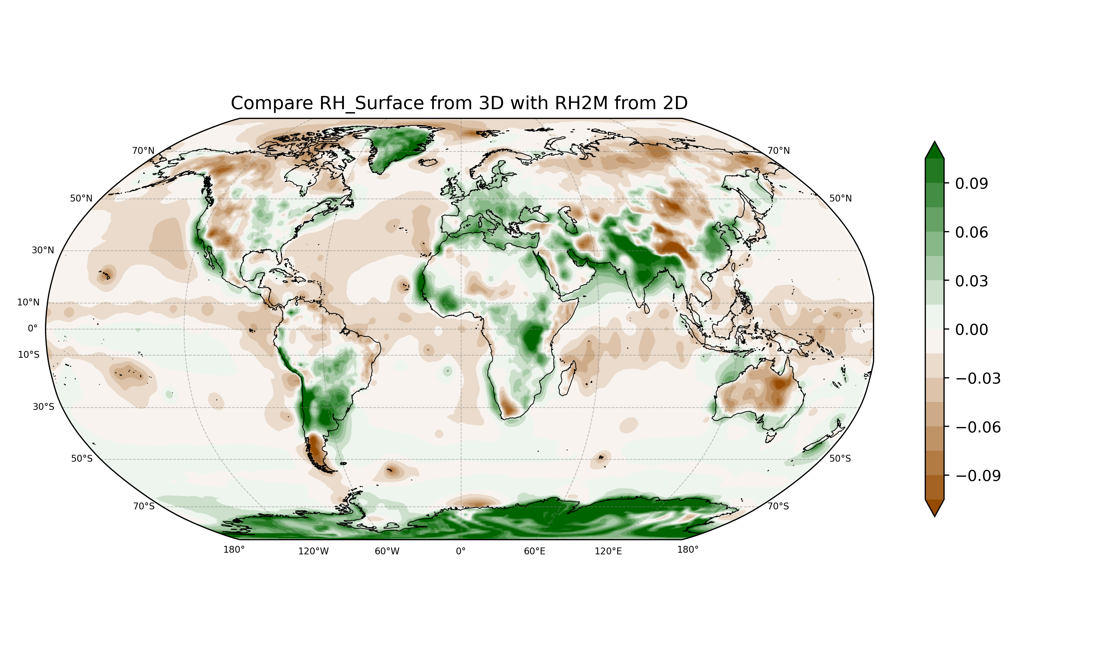
Merra-2
Merra-2
JRA-55
JRA-55

Slide 33
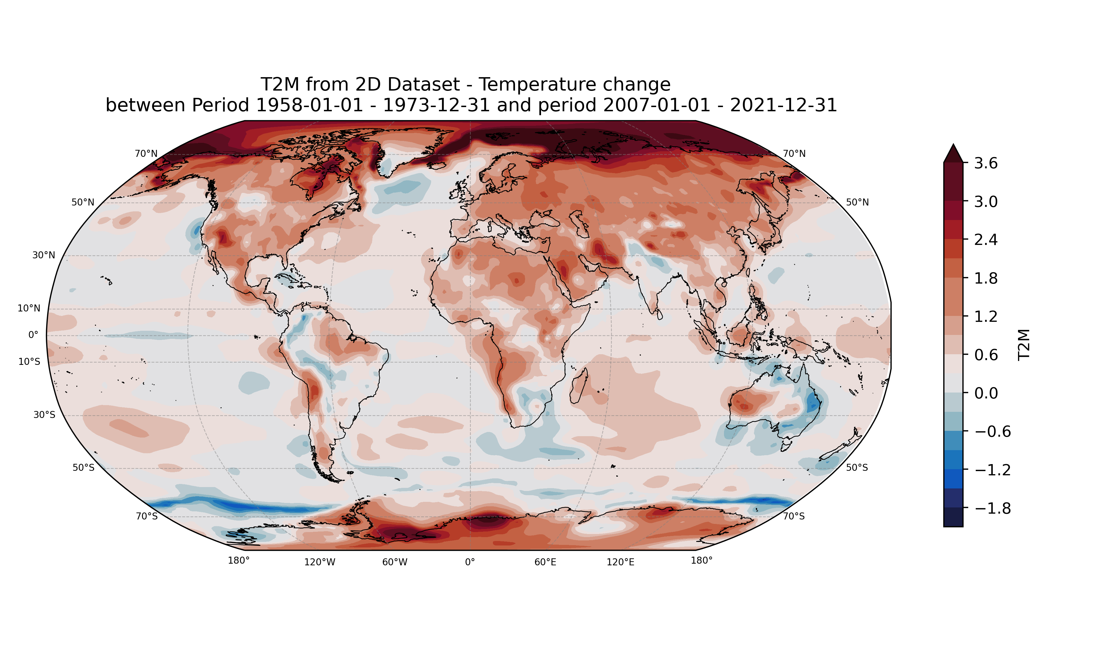
of 3D Data (highest p - level)

Slide 34
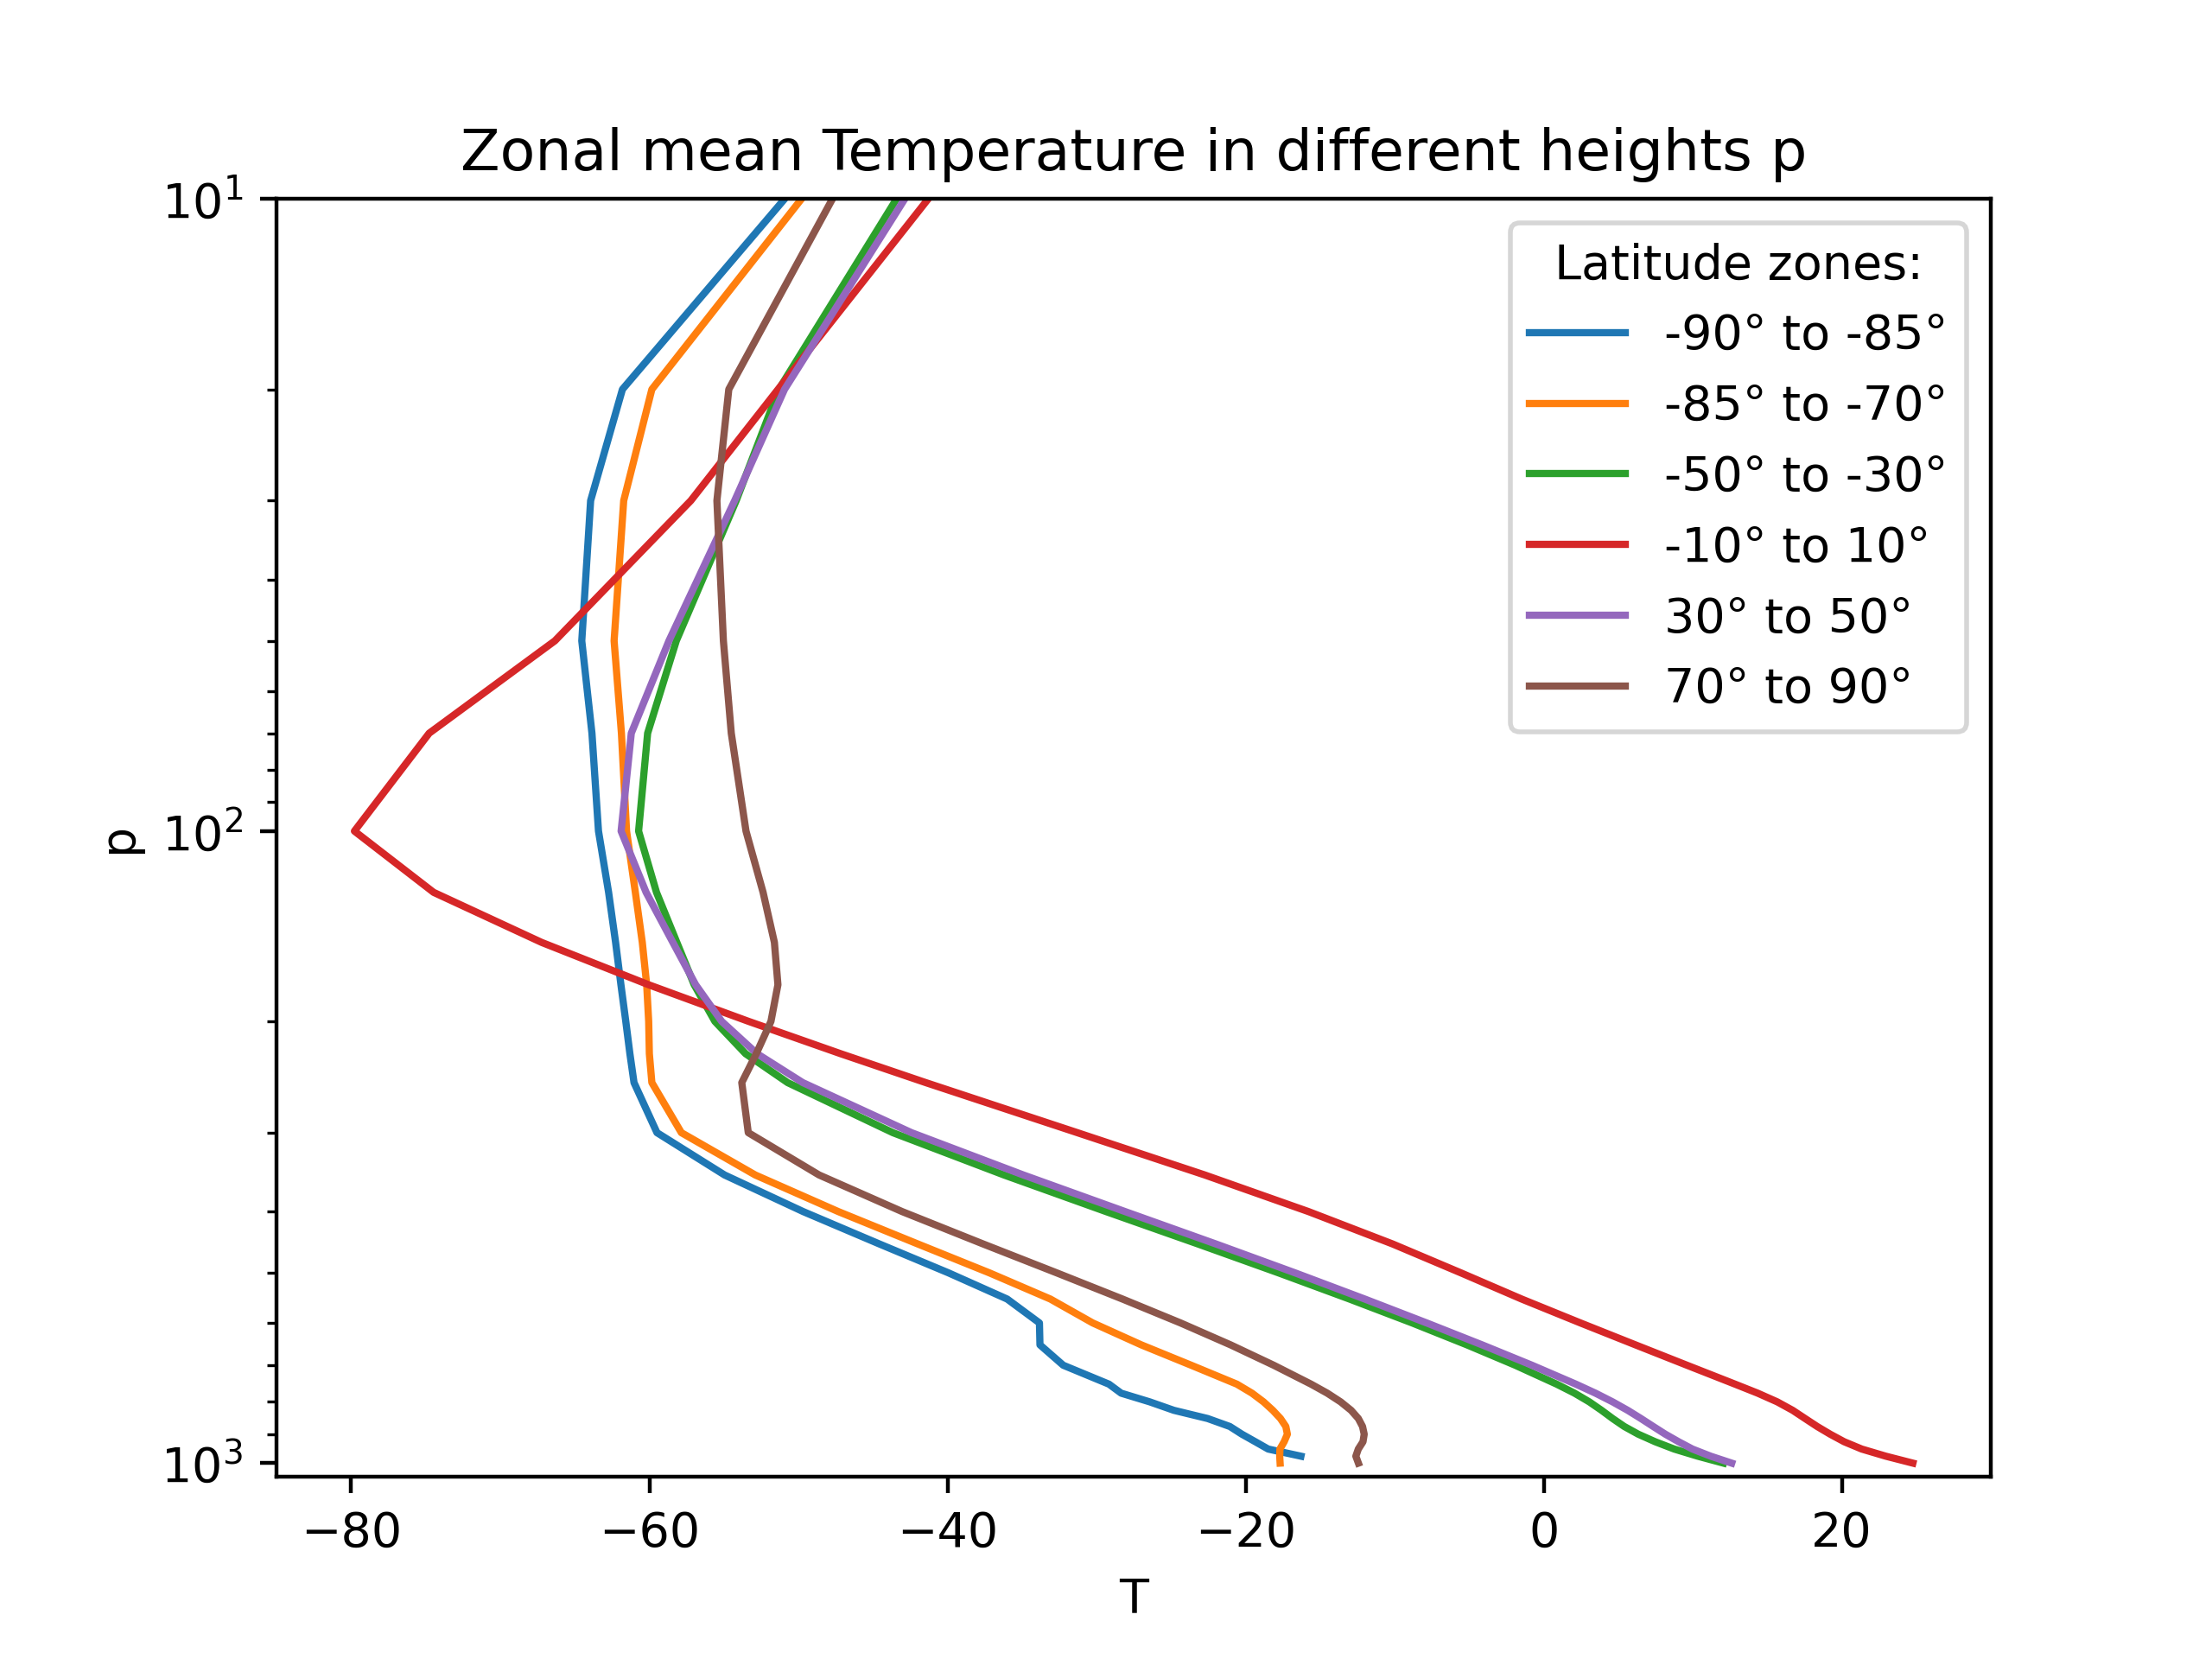
Temperature profile

Slide 35
Clausius–Clapeyron Equation
Solution:
@ https://www.e-education.psu.edu/meteo300/node/584
Notes:
https://www.e-education.psu.edu/meteo300/node/584
l_{v} is the enthalpy of vaporization (often called the latent heat of vaporization, about 2.5 x 10⁶ J kg^{–1}),
l_{v} is not constant with temperature but instead changes slightly (from 2.501 x 10⁶ J kg^{–1} at 0 ºC to 2.257 x 10⁶ J kg^{–1} at 100 ºC).

Slide 36
